Slide 1
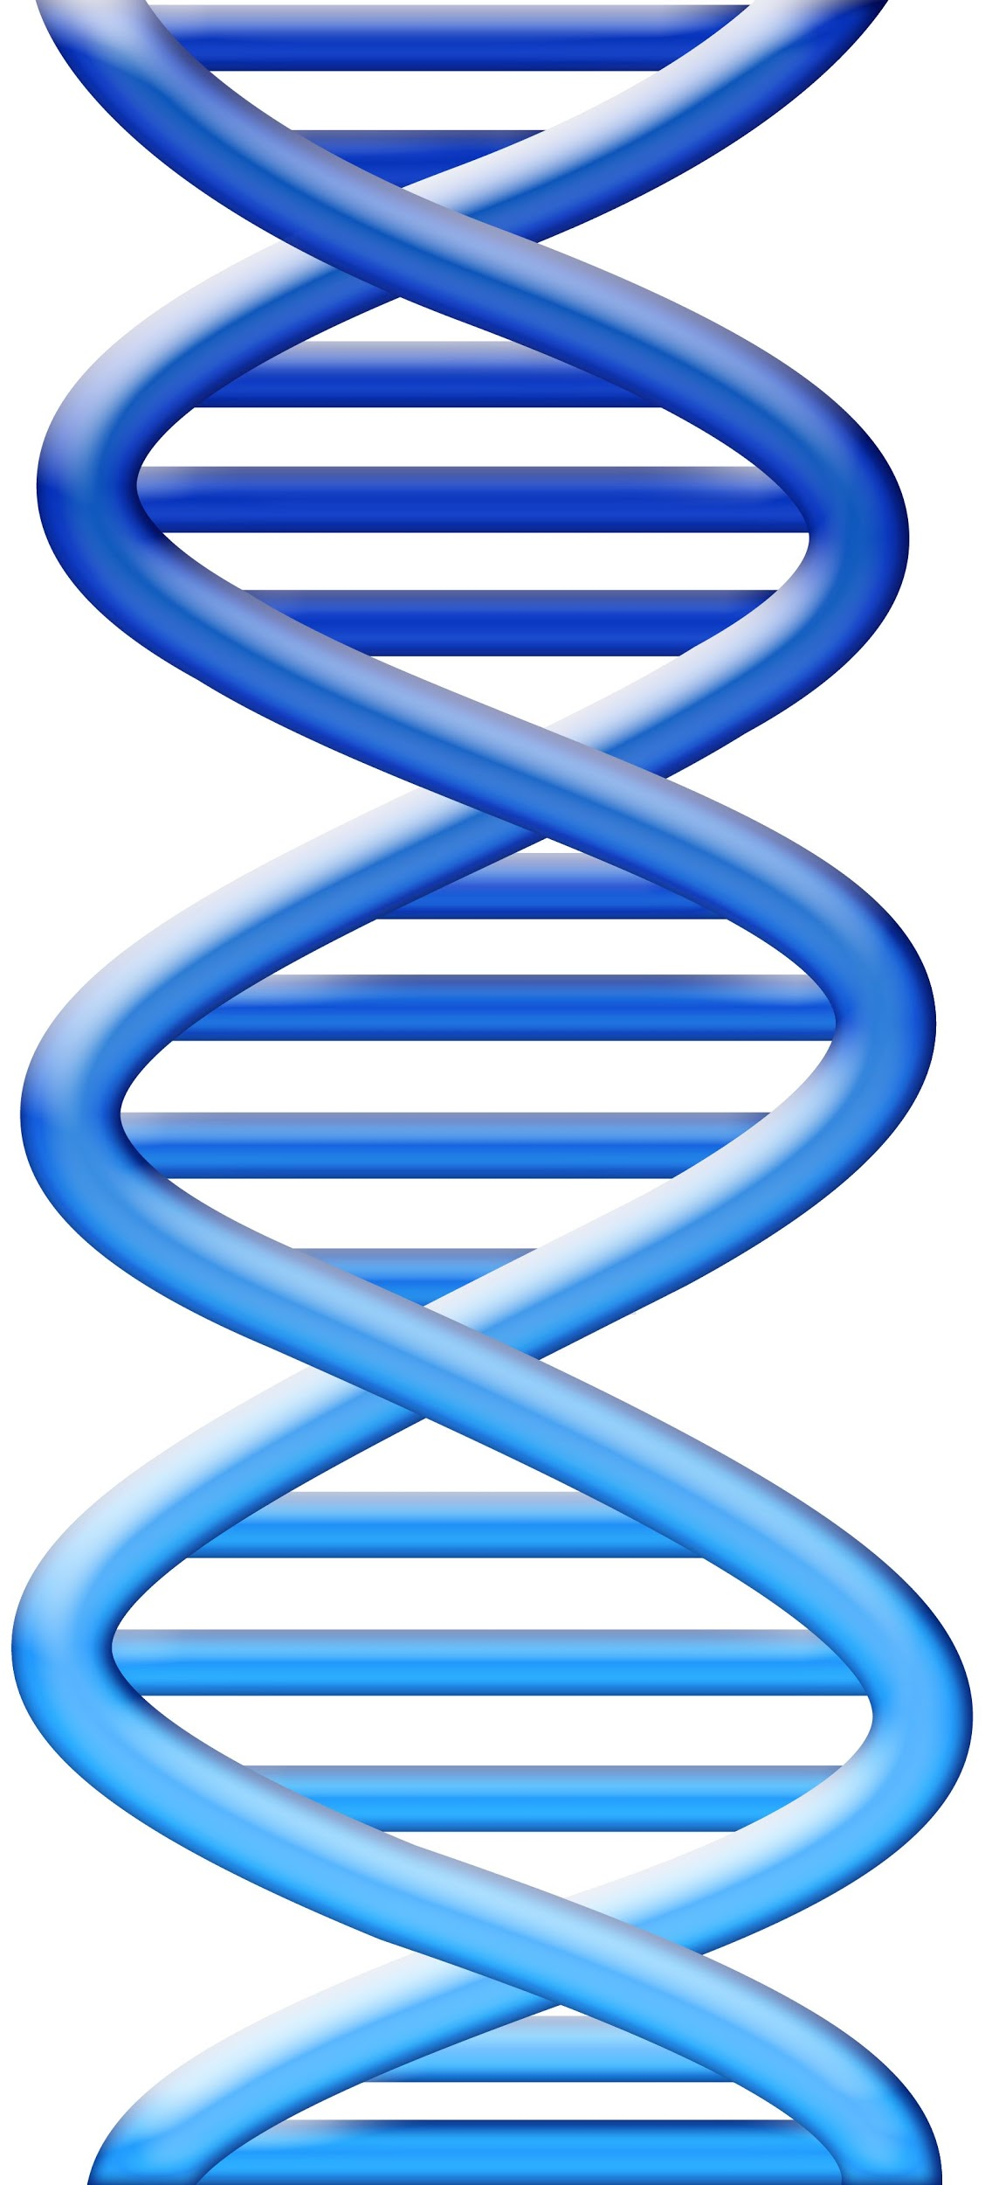
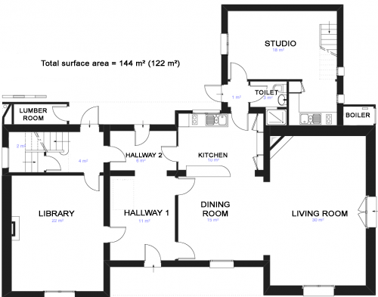
DNA
Why is DNA called "The Blueprint of Life"

Slide 2
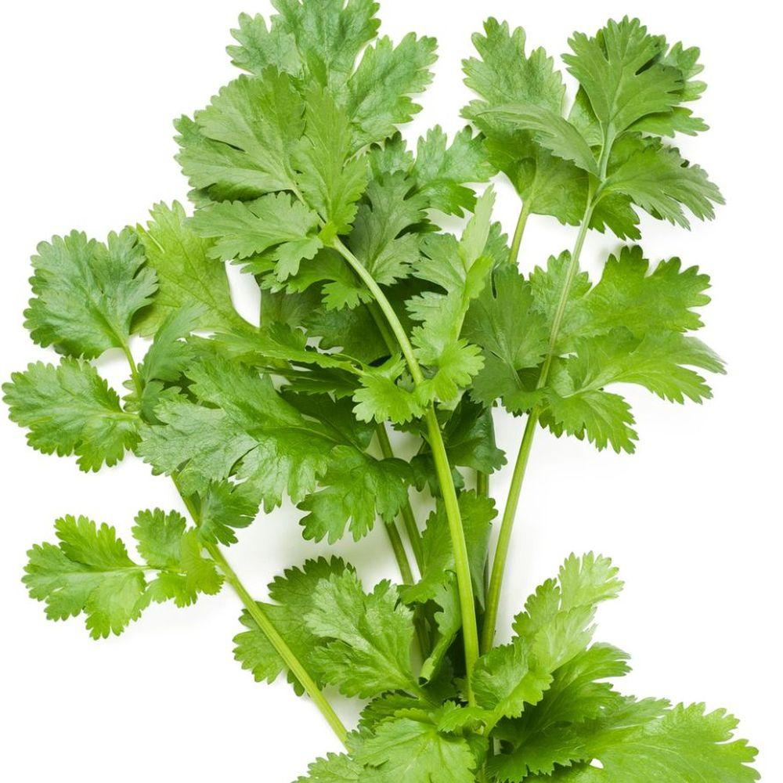
1. How can small changes in DNA lead to big changes in traits?
Do you like cilantro?
Some people think it tastes like soap.
Some traits we can see, like curly coats in dogs.
Some traits we cannot see, like the ability to taste chemicals.
Notes:
This is your anchoring phenomenon.

Slide 3
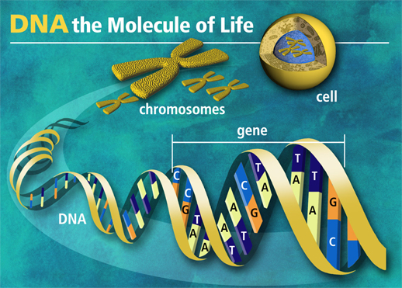
2. DNA stands for...
DeoxyriboNucleic Acid
It is found in all cells, packed tightly within chromosomes in the nucleus of every .
Segments of DNA code for traits - what we call GENES.

Slide 4
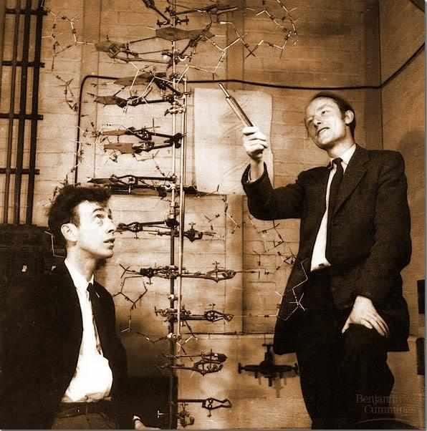
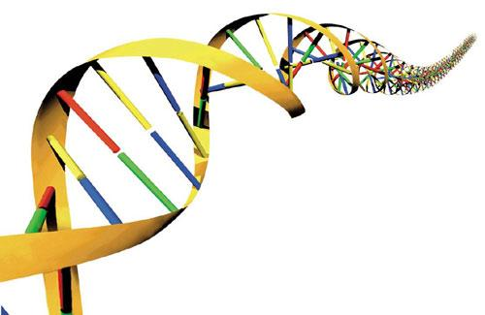
3. Structure of DNA
was established by James Watson and Francis Crick

Slide 5
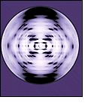
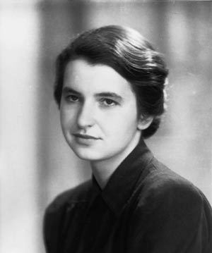
4. Rosalind Franklin photographed DNA using X Rays
The shape of DNA is a double helix.
Think of it like a twisted ladder.

Slide 6
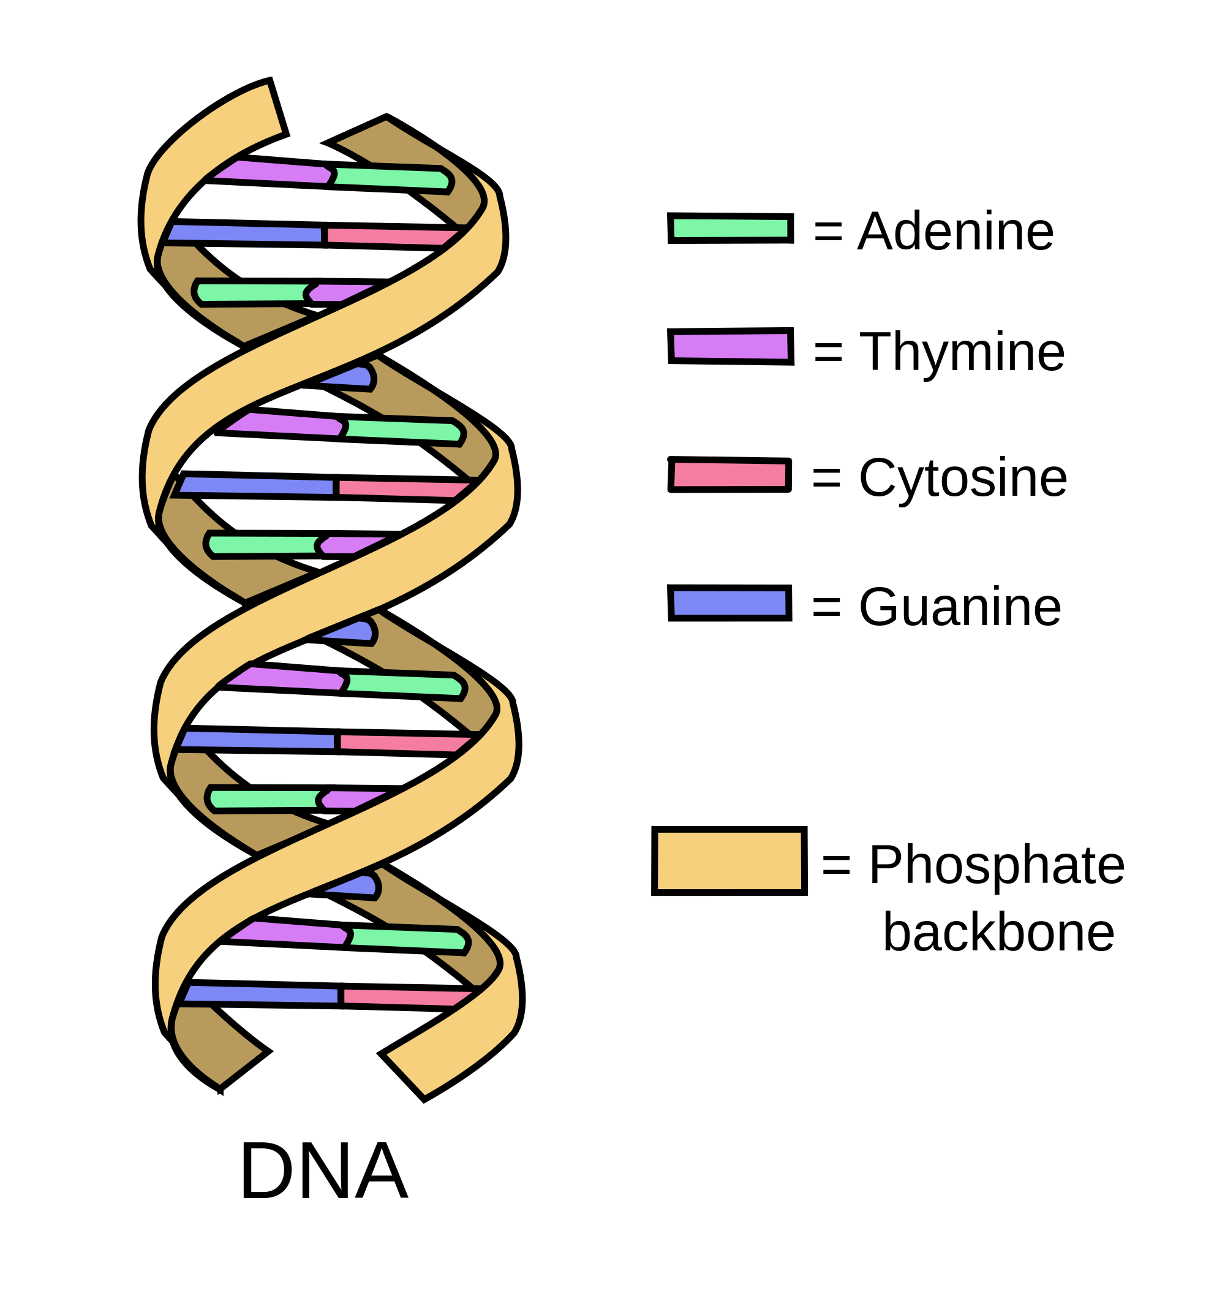
DNA is made of repeating subunits called nucleotides.
Each nucleotide can have one of 4 bases
Adenine Thymine
Guanine Cytosine

Slide 7
6. A closer look at a nucleotide:
Has three parts:
PHOSPHATE
DEOXYRIBOSE (sugar)
BASE (A,T,G,C)
Phosphate
Base
Sugar

Slide 8
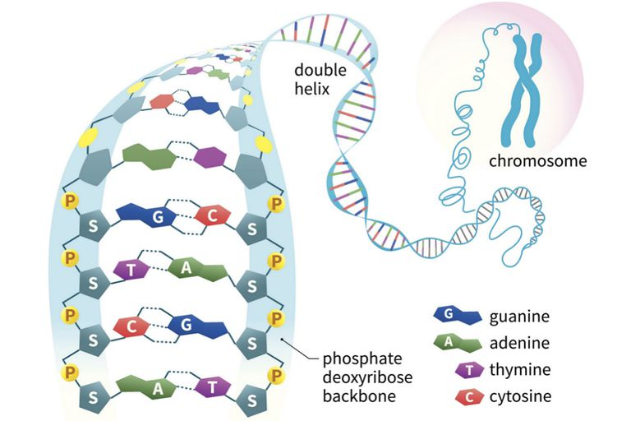
7. DNA has millions of nucleotides
How many can you count in this area?

Slide 9
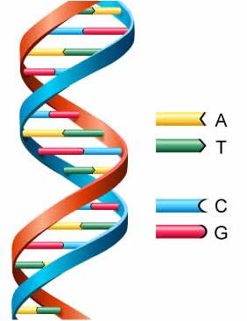
8. The bases on a string of DNA are the code.
Bases are like letters.
Letters form words....
Words form sentences....

Slide 10
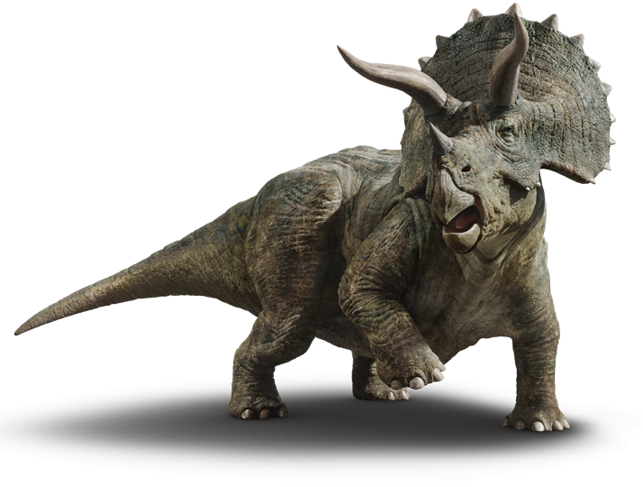
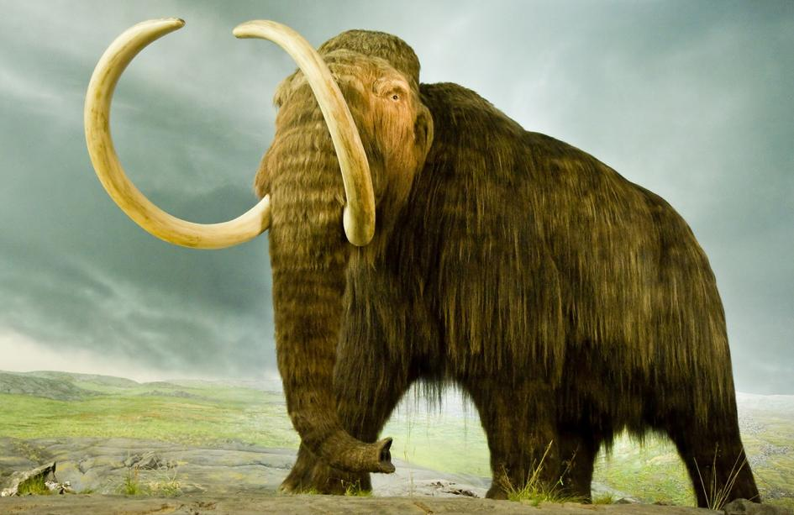
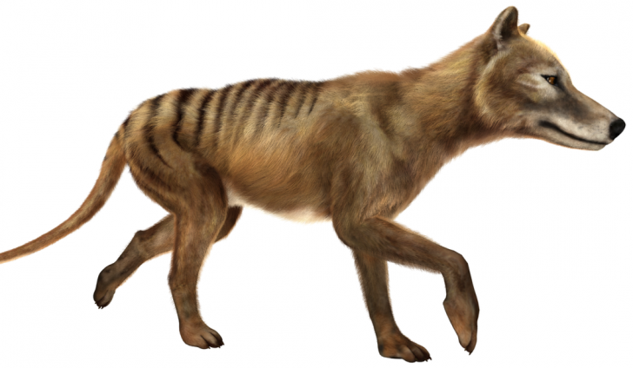
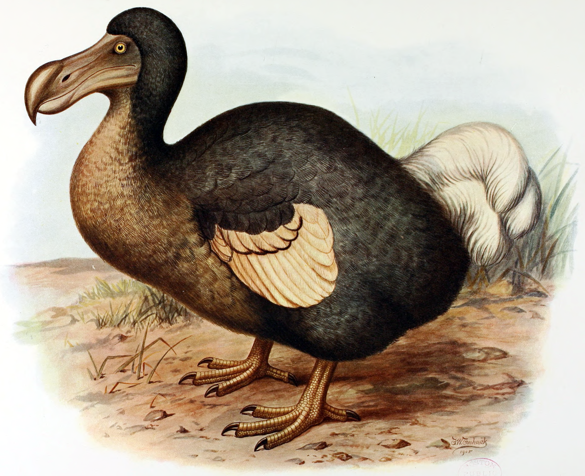
9. DNA contains the instructions to build the organism.
Could we use DNA to grow organisms that have become extinct?
We can potentially CLONE extinct animals.

Slide 11
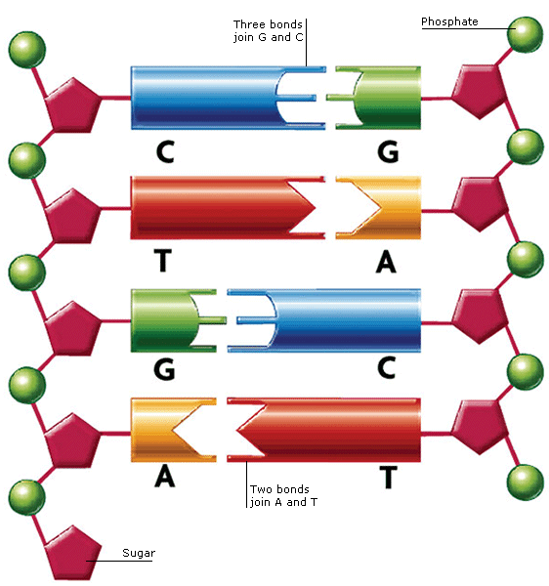
10. Base-Pair Rule
Adenine <==> Thymine
Guanine <==> Cytosine
The sides of the DNA ladder are phosphate & sugar

Slide 12
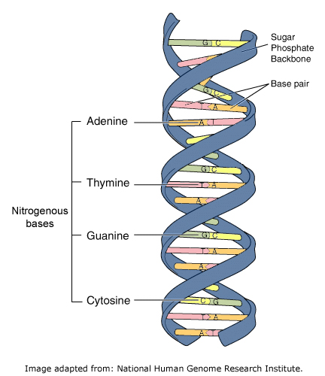
11. Applying the Base Pair Rule
One side: A T A T C A T G C G G G
Other side:

Slide 13
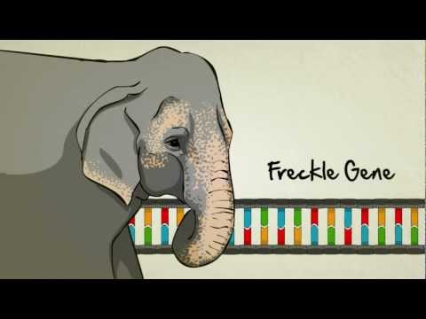
12. Video “Stated Clearly: What Exactly is a Gene?”

Slide 14
13. Drawing Task. Let’s put all of this knowledge together and draw our own DNA.

Slide 15
Let's Review What We Know About DNA
1. DNA stands for: De _____ ribo ______ acid
2. What is the shape of DNA? ______________
3. Who established the structure of DNA? __________________
4. The sides of the DNA ladder are deoxyribose and _________
5. Guanine always pairs with _____________
6. Thymine always pairs with _____________
7. Sequences of bases make up _______________.
8. Genes code for ___________________.

Slide 16
True or False
1. All living things have DNA.
2. DNA can be found in the nucleus of cells.
3. DNA is made of thousands of chromosomes.
4. A strand of DNA contains only about 20 nucleotides.
5. The bases (A, T, G, C) can occur in any order.
6. Each chromosome has only one gene.

Slide 17
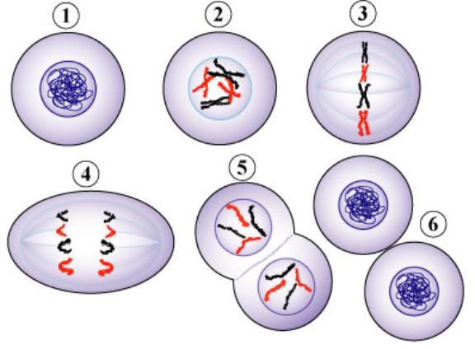
14. DNA REPLICATION
the process by which DNA makes a copy of itself
When does replication happen in the cell cycle?
INTERPHASE

Slide 18
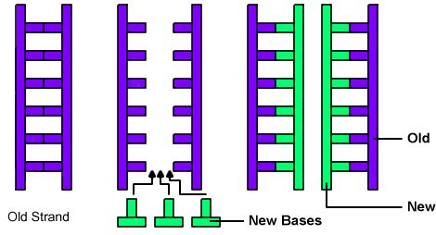
15. Replication is Semi- Conservative
- the old strand serves as a template for building the new strand
- each new copy has one half of the original
- this can reduce copy errors

Slide 19
16. Getting the message out
- DNA stays in the nucleus
- It is used to make messenger RNA (mRNA)
- RNA contains the code to build proteins
- RNA leaves the nucleus and heads to the ribosomes where proteins are made

Slide 20
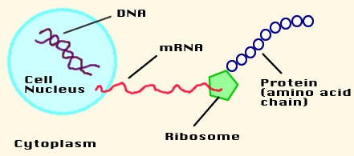
17. The Central Dogma
SUMMARIZE:

Slide 21
18. RNA - the messenger
-single strand
-contains ribose sugar
-contains no thymine, uracil instead -follows base pair rule, but A ⇒ U
DNA: A T A G C G T G A
RNA:

Slide 22
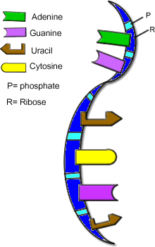
19. RNA carries the "message" to the ribosomes, where proteins are made

Slide 23
20. Quick review: What is a gene?
A section of DNA, with many bases that codes for a protein
Proteins build structures in the body, resulting in the traits you see.

Slide 24
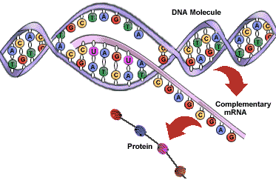
21. How does DNA make a protein?
DNA letters are the code which tells the cell knows what protein to build.
Every 3 letters (AAA) specifies a single amino acid.

Slide 25
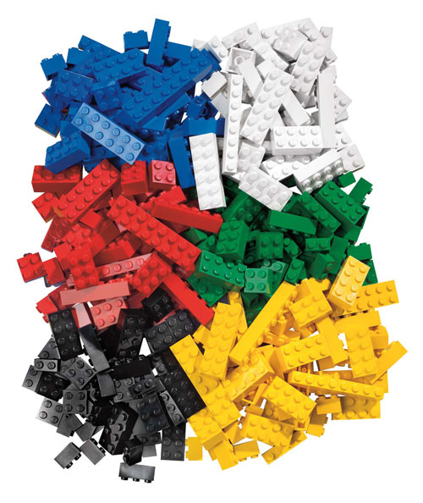
22. Amino acids are building blocks, they make up proteins.
Some are FUNCTIONAL
-lactase breaks down lactose in milk
Some are STRUCTURAL
- proteins that make up muscles and blood cells
Think of amino acids like legos, you can arrange them in lots of different shapes and configurations!

Slide 26
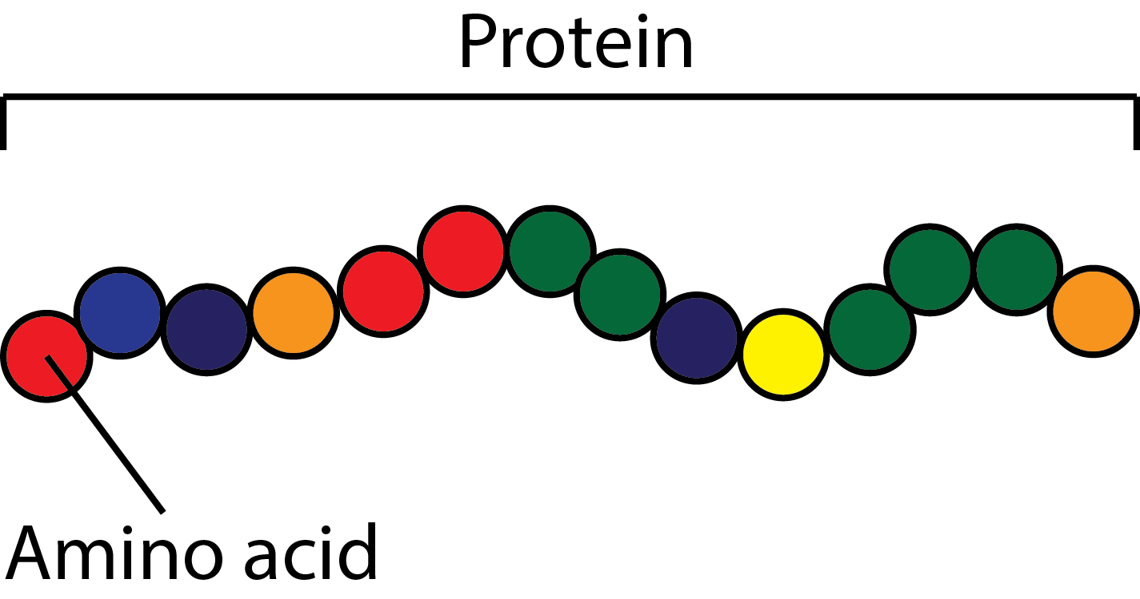
23. Proteins are made of chains of amino acids.
There are 20 amino acids that can be arranged in any number of ways. The arrangement determines the function.

Slide 27
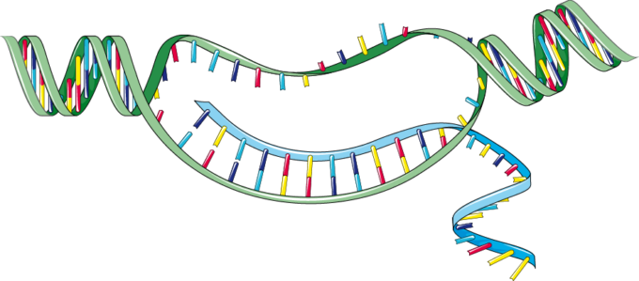
24. How to get from a gene on DNA to a protein made by a ribosome.
Step 1 - DNA must be made into a molecule of messenger RNA that will take the code out of the nucleus and to the ribosomes.
This process is called TRANSCRIPTION.
DNA Strand
A A A C C C C A T
RNA:
Create an RNA strand following the base pair rule (RNA has Uracil instead of Thymine)

Slide 28
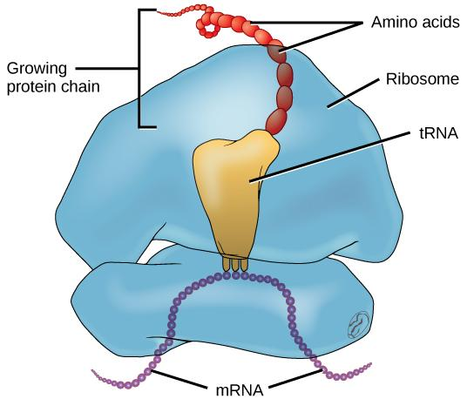
25. Step 2: RNA travels to the ribosomes
Ribosomes use the code on the mRNA to build a chain of amino acids.
This process is called TRANSLATION.

Slide 29
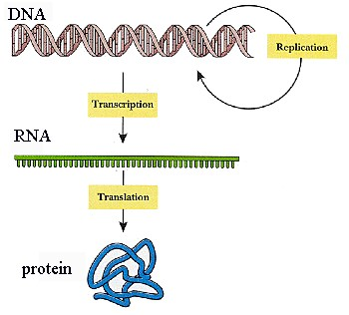
Transcription - process where RNA is made from DNA
26. Overview of the whole process:
Translation - process where proteins are made from RNA

Slide 30
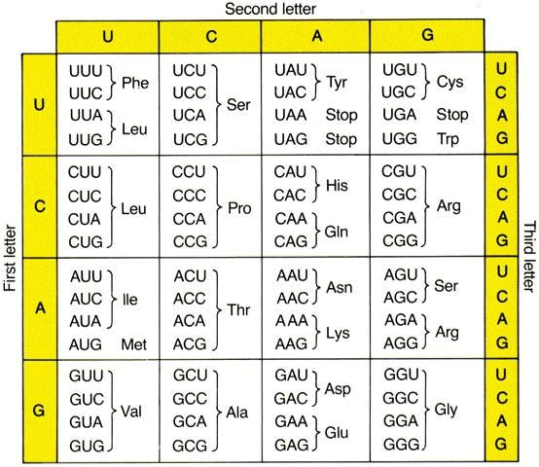
27. Each 3 bases on mRNA is called a CODON.
Each codon codes for 1 amino acid.
What amino acid is made from:
A A A
U U U

Slide 31
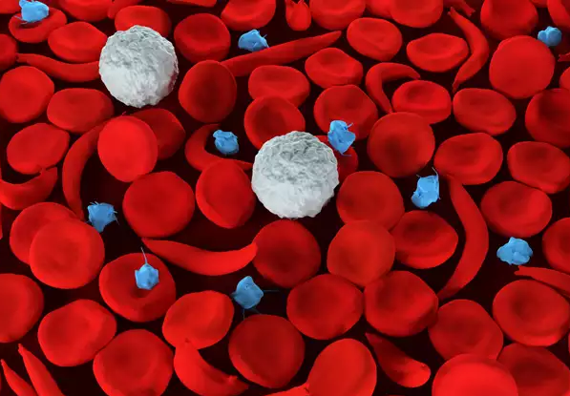
28. Hemoglobin is a protein that makes up red blood cells.
The bases in your DNA tell your cells how to make red blood cells.
If a single letter in the DNA is changed, the cells can change shape.

Slide 32
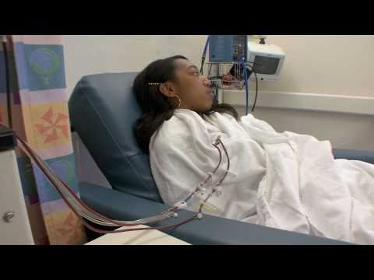
29. What is it like to live with sickle cell disease?

Slide 33
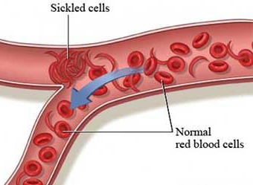
30. Sickle Cell Disease
The change in the shape means that the blood cells don’t move through vessels easily.
Symptoms:
- Anemia
- Pain
- Swelling of hands and feet
- Delayed growth
- Problems with vision
Let’s take a closer look at how one small change in DNA can lead to this lifelong illness.
DNA, Proteins and Sickle Cell

